Slide 1
Machine Learning Assighnment Customer Transactions by SHIVAM DHUMAL

Slide 2
Q) “How can we best cluster our customers and get a view on Cluster_Customer x (Recency, Frequency & Monetary)”.
marketing
By Analysing the data we can say that we can use (Model Description): RFM Segmentation
The code implements a customer segmentation technique called RFM segmentation. RFM stands for Recency, Frequency, and Monetary value. This approach categorizes customers based on these three key behavioral aspects:
Recency: How recently a customer made a purchase (in days for this code).
Frequency: How often a customer makes purchases (number of transactions in this code).
Monetary: How much a customer spends in total (total spending in this code).
By analyzing these factors, the model assigns customers to different segments, allowing businesses to tailor marketing strategies to each group's specific needs and behaviors.

Slide 3
RFM Model by K-Means clustering Algorithm.
K-Means Clustering
Algorithm: K-Means clustering is a partitioning method that divides data into K distinct clusters based on their features.
Mechanism: It iteratively assigns data points to one of K clusters by minimizing the within-cluster sum of squares (variance). Each cluster is defined by its centroid, which is the mean of all points in that cluster.
Choice of K: For this analysis, K=4 was chosen to create four distinct customer segments based on Recency, Frequency, and Monetary value (RFM).
Why K-Means?
Simplicity: Easy to implement and interpret, making it suitable for customer segmentation.
Scalability: Efficiently handles large datasets, which is often the case with customer transaction data.
Effectiveness: Provides clear and actionable segmentation, which can be directly utilized for marketing strategies.

Slide 4
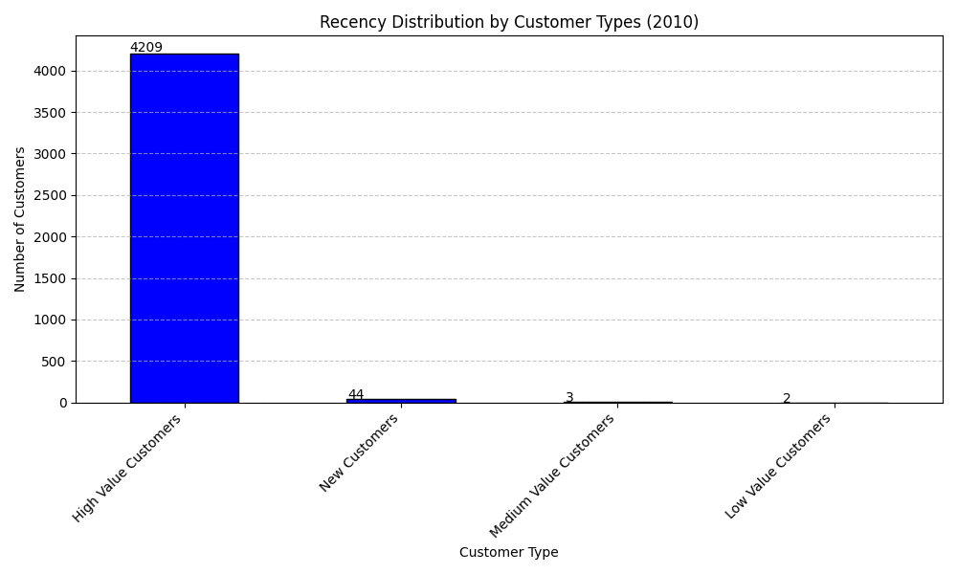

VIEW
The clusters are divided into 4 types of 2010 and 2011 dataset
High value Customers
Medium value customers
New customers
Low value customers ( details on the next slide)

Slide 5
Marketing Strategies
1. High Value Customers
Characteristics:
Recency: Low (recent purchases)
Frequency: High (frequent purchases)
Monetary: High (high total spending)
Marketing Strategies:
Loyalty Programs: Implement loyalty rewards (e.g., points, exclusive deals) to retain these valuable customers use discount for them
Exclusive Offers: Provide exclusive discounts, early access to new products, and special promotions to show appreciation and encourage continued loyalty.
Personalized Communication: Use personalized marketing messages, leveraging their purchase history to suggest new or complementary products.
Premium Services: Offer premium services or memberships, such as priority customer service, to enhance their experience.

Slide 6
Medium Value Customers Characteristics:
Recency: Moderate (purchases within a reasonable time frame)
Frequency: Moderate (occasional purchases)
Monetary: Moderate (moderate total spending)
Marketing Strategies: Upsell and Cross-sell: Recommend products that complement previous purchases to increase their average order value.
Engagement Campaigns: Send targeted emails and newsletters to keep them engaged and encourage more frequent purchases.
Incentive Programs: Offer incentives, such as discounts or free shipping, for reaching a certain spending threshold.
Feedback Surveys: Conduct surveys to gather insights on their preferences and satisfaction, using this information to tailor future marketing efforts.

Slide 7
Low Value Customers
Characteristics:
Recency: High (long time since last purchase)
Frequency: Low (infrequent purchases)
Monetary: Low (low total spending)
Marketing Strategies:
Re-engagement Campaigns: Use email marketing campaigns with special offers, discounts, or personalized messages to re-engage these customers.
Comeback messages , discounts and referrals
Win-back Strategies: Identify why these customers have low engagement and address those reasons. Offer limited-time offers or bundles to incentivize a return purchase.
Educational Content: Share content that educates them about product benefits, usage tips, and other relevant information to increase perceived value.

Slide 8
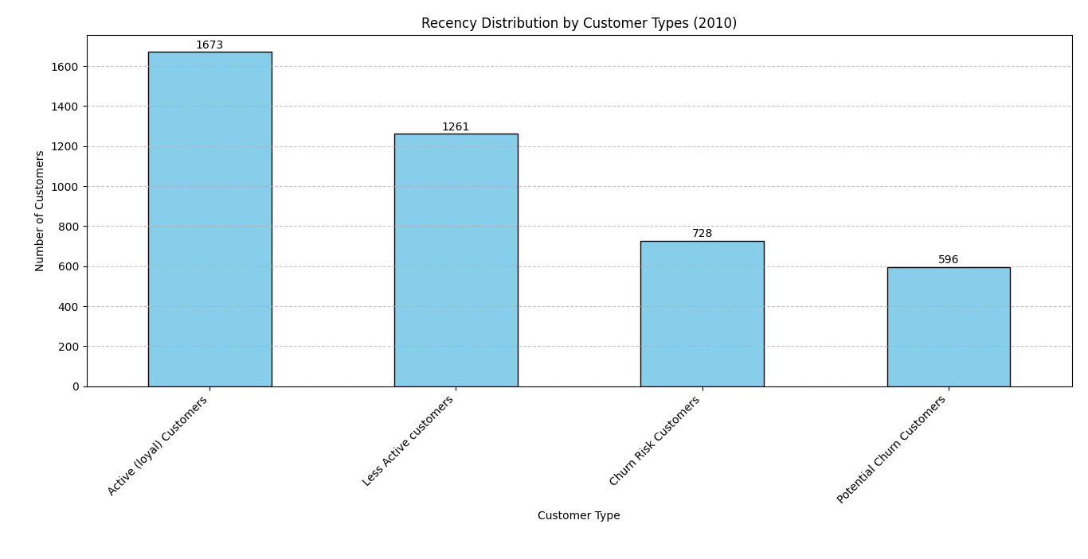
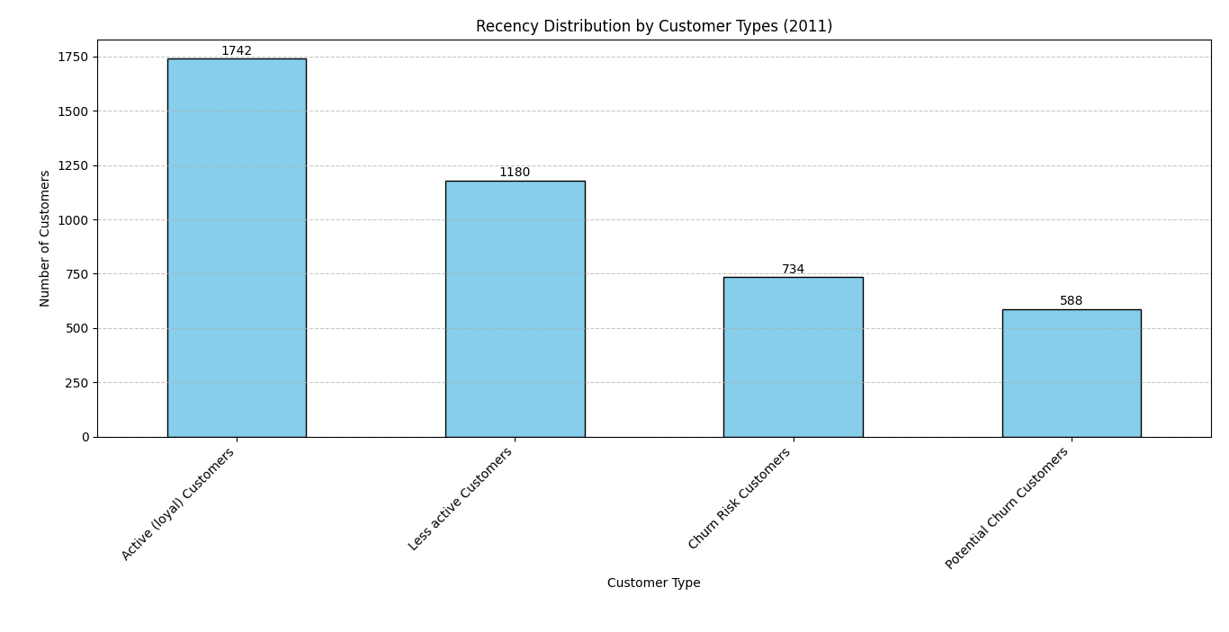
Going more deep in … with Recency model
Another model is only based on the Recency which
Actually gives exact values of the customer types
(Code is available in pdf)
This is actually the customer types and there perfect number count in 2010 and 2011

Slide 9
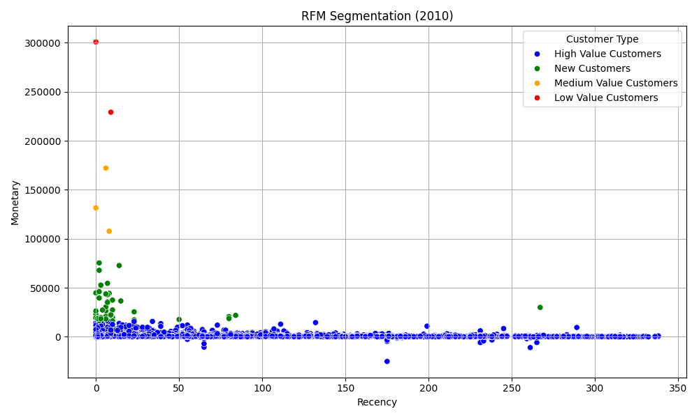
Well this is actually the segmentation graaph for more clarity and understanding purposes

Slide 10
Retail Product Team
How it works
The Model performs a market basket analysis on sales data to identify the next best product (weekly) to recommend for the top 10 selling products based on the Average Basket Index (ABI). Here's a brief explanation of each step:
Calculate ABI Index:
Group sales data by invoices to determine which items were bought together.
Create pairs of items bought together and count their occurrences.
Divide the count of each pair by the total number of transactions to get the ABI index for each pair.
Identify Top 10 Selling Stock Codes:
Sum the quantities sold for each stock code.
Sort the stock codes by total quantity sold and select the top 10.

Slide 11
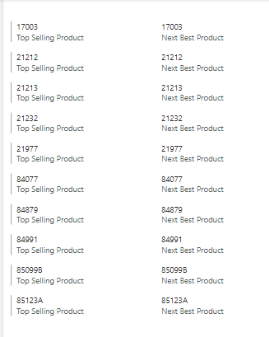
Find Next Best Product for Each Top-Selling Product:
For each top-selling product, filter the ABI index to find pairs involving the product.
Select the product with the highest ABI index as the next best product, excluding pairs of the product with itself.
Finally, the results are displayed in a table showing each top-selling product and its next best product recommendation.
This is the list of the Top selling Products and Next Best products there (stockCode)
We can extract there names also with the model
Best Strategies =
Keep the products side by side but in most spacious corners of the store , it should be visible
Keep them in one place but keep other products like the same index in between them

Slide 12
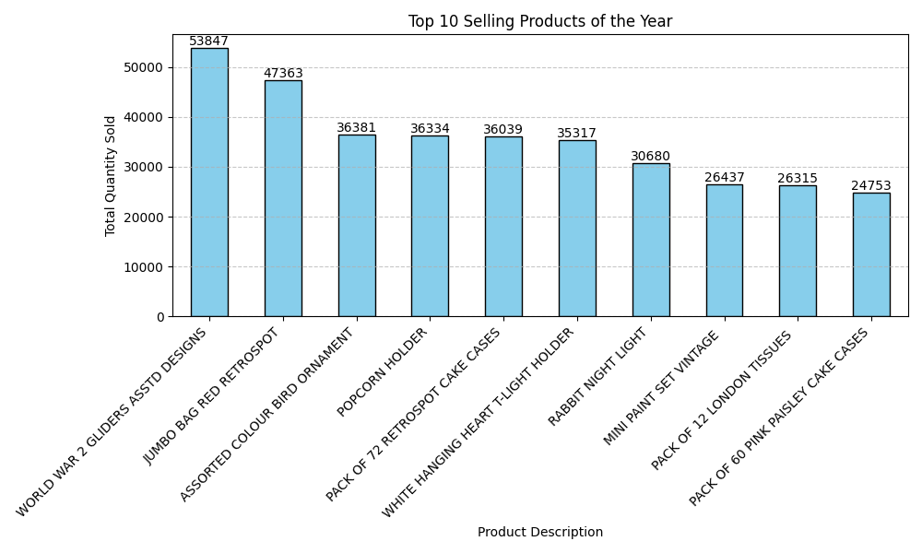
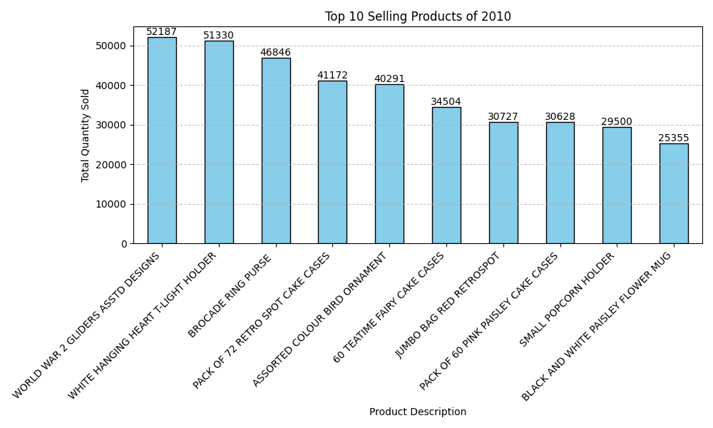
final tips & takeaways
These are the Top selling products of the 2011 and 2010 , extracted by the model , this need to kept in the place where other products are easily available
WOLD WAR 2 GLIDERS WON THE MOST SELLING AWARD
Model code in pdf (link)

Slide 13
Another Model for ABI directly gives the values and graph
Second data model using ABI index and matplotlib
This code analyses customer transaction data for the year 2010 to calculate the Average Basket Item (ABI) index for each product pair. The ABI index indicates the likelihood of two products being purchased together in the same transaction. Here's a breakdown:
Data Loading: Transaction data is loaded from an Excel file into a Pandas DataFrame.
Date Formatting: The 'InvoiceDate' column is converted into datetime format for ease of manipulation.
Year Filtering: Data is filtered to include transactions only from the year 2010.
ABI Index Calculation: A function calculate_abi_index is defined to compute the ABI index for each product pair. It iterates through unique stock codes, calculates the co-occurrence of each pair in transactions, and computes the ABI index based on the proportion of occurrences of one product alongside another.
ABI Index Visualization: The ABI index matrix for 2010 is visualized using a heatmap. Each cell in the heatmap represents the ABI index between two products, with higher values indicating a stronger association between them. Seaborn's heatmap function is utilized for visualization, annotating each cell with the ABI index value.
Plot Customization: The heatmap is customized with titles, labels, and rotation of x and

Slide 14
Customer relationship management model:
“How can we know which customers are about to churn?
This model is the answer
(Description of the model )
Loading the Dataset: The dataset containing customer transactions is loaded from an Excel file.
Converting InvoiceDate to Datetime Format: The InvoiceDate column is converted to a datetime format for easier manipulation and calculation.
Calculate Recency: Recency, defined as the number of days since the last purchase, is calculated for each customer. This involves:
Finding the most recent purchase date for each customer.
Calculating the number of days between the current date and the most recent purchase date.

Slide 15
Calculating the Monetary Value: The total spending for each customer is calculated by multiplying the quantity of items purchased by their price.
Merge Recency and Monetary Data: The Recency and Monetary values are merged into a single DataFrame.
Set Thresholds and Filter Churn Candidates: Customers are filtered based on specified thresholds for Recency (90 days) and Monetary value (1000 currency units).
Add Customer Information: Customer names and countries are added to the filtered churn candidates list
Display and Export Churn Candidate Information: The churn candidate information is displayed and then exported
Next slide consist of the POWER BI dashboard and excel file is in drive

Slide 16
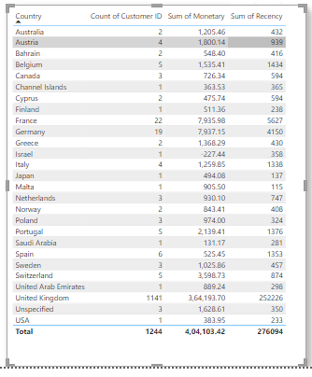
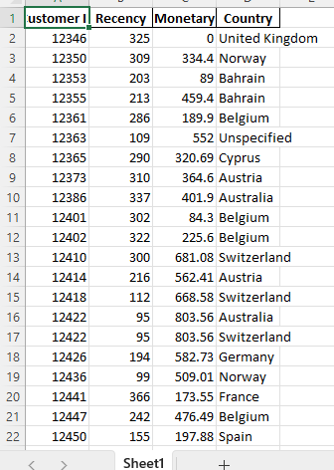
The dataset contains the customer IDs extracted with the help of models

Slide 17
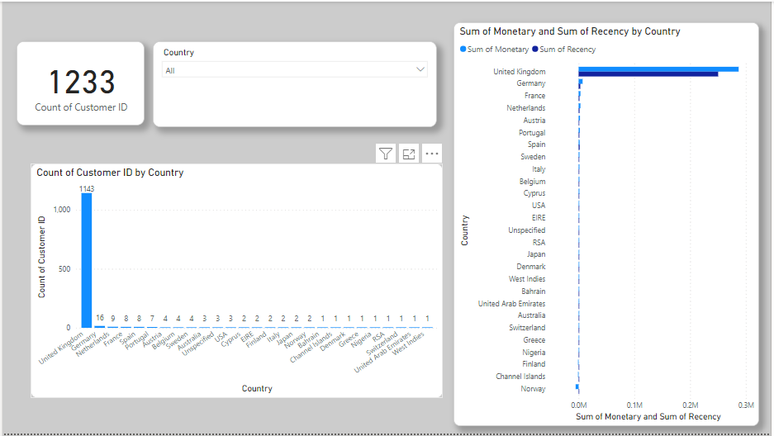
THIS IS THE POWER BI DASHBOARD SO YOU CAN FOCUS ON THE CHURN CUSTOMERS
This is the country dropdown

Slide 18
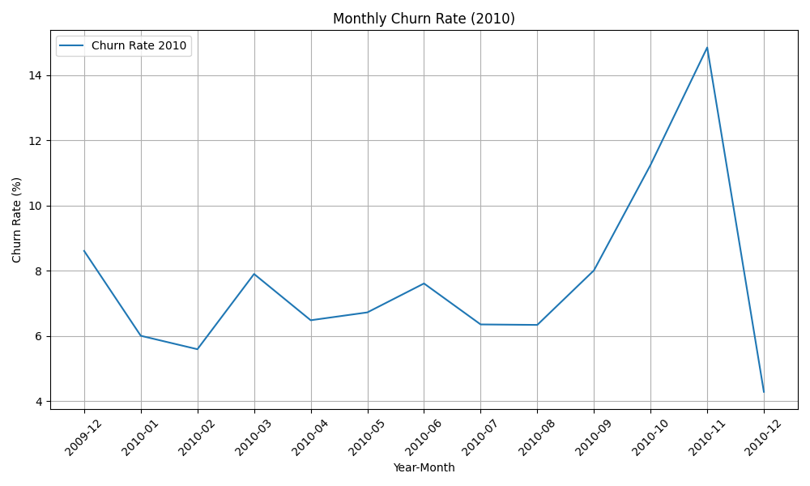
Monthly Churn Rate of 2010 with compared to year

Slide 19
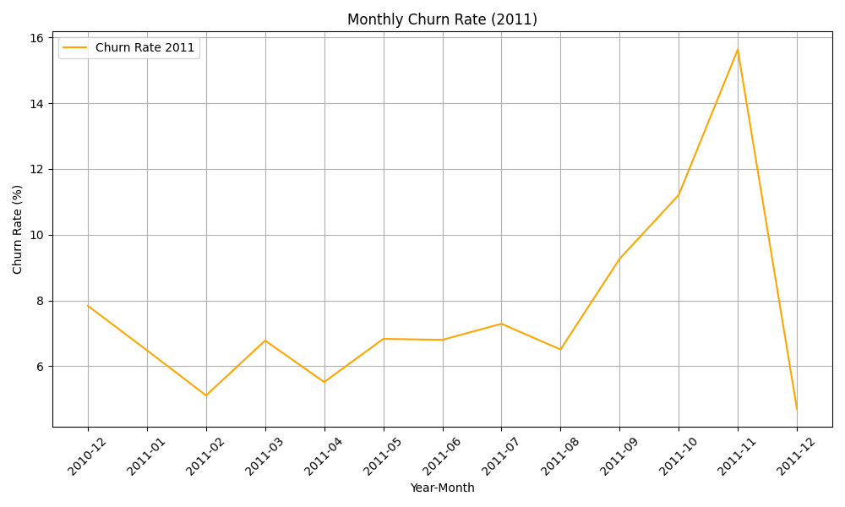
Monthly Churn Rate of 2011 with compared to year

